Slide 1
Presentation on AllAboutGhorbari.net
A php based website for buying, selling, advertising houses
and many more!

Slide 2
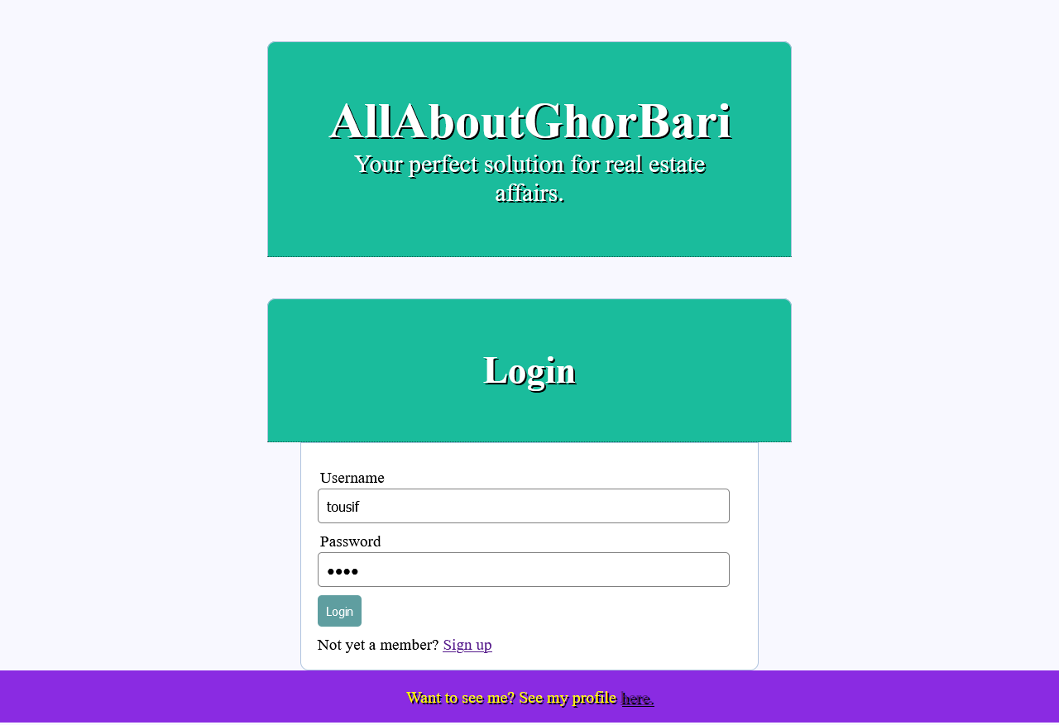
Features: Login + Landing page

Slide 3
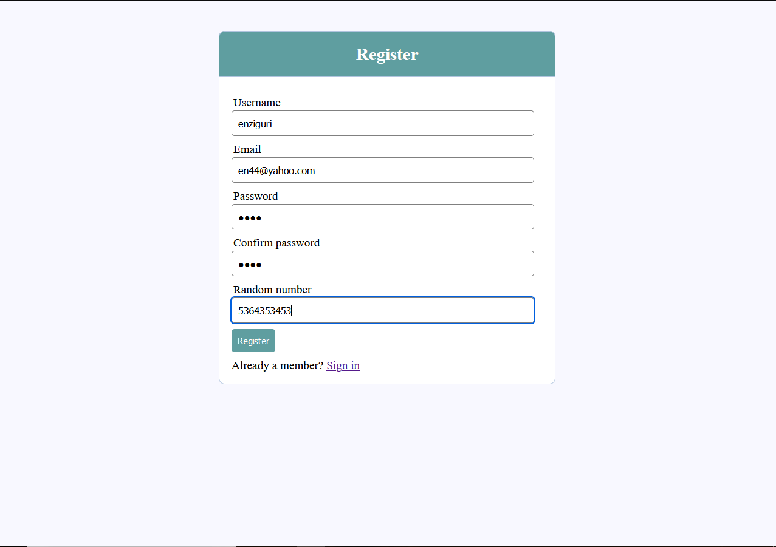
Features: Registration of new user

Slide 4
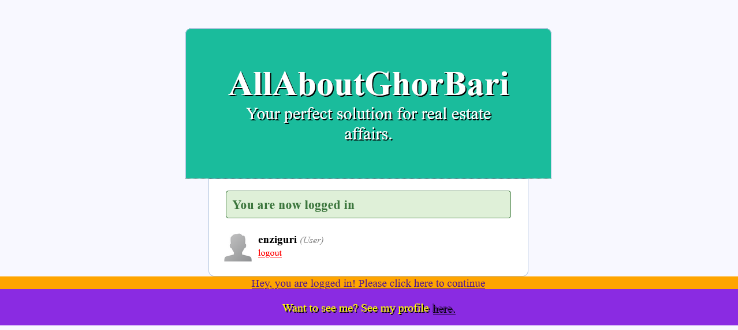
Features: login confirmation and logout screen

Slide 5
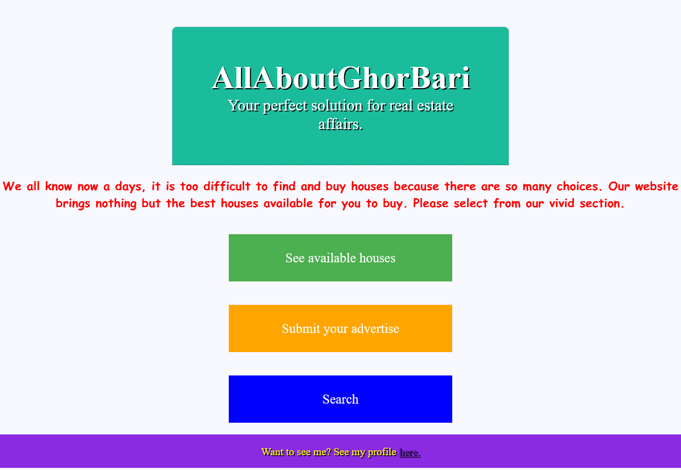
Features: Menu

Slide 6
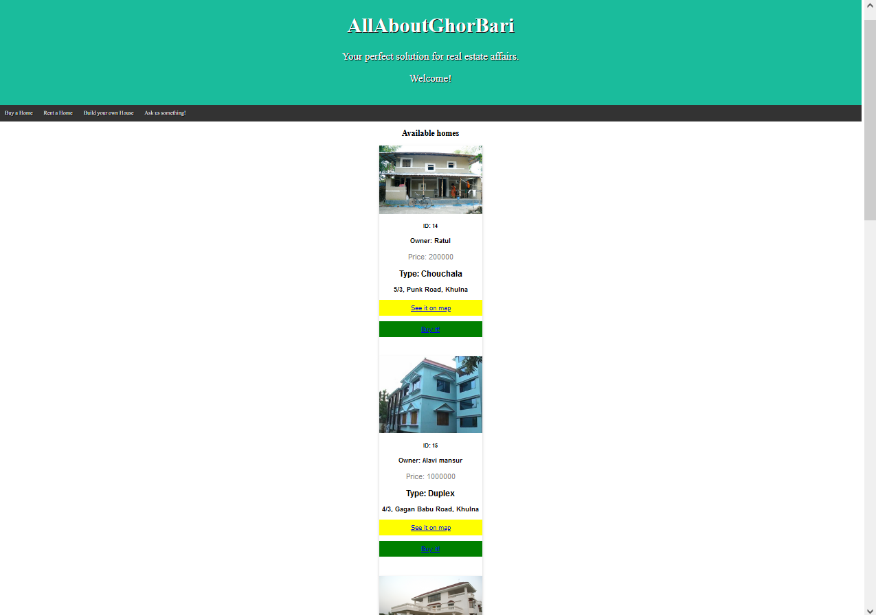
Features: see available houses

Slide 7
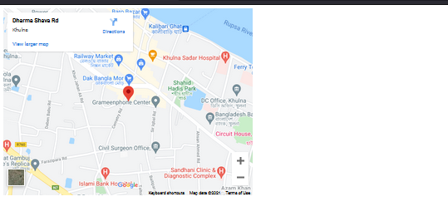
Features: see it on map

Slide 8
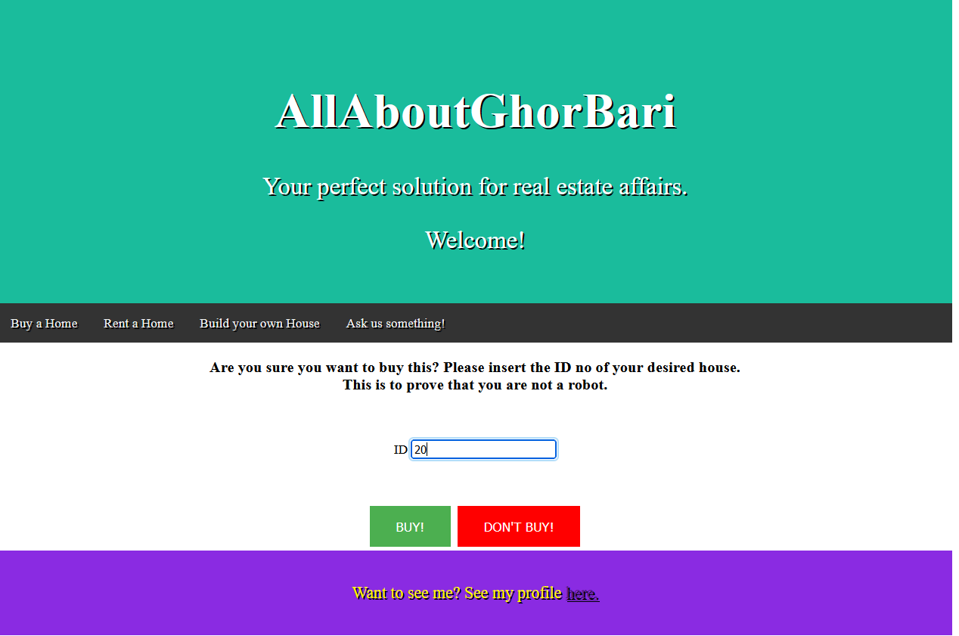
Features: Buy house

Slide 9
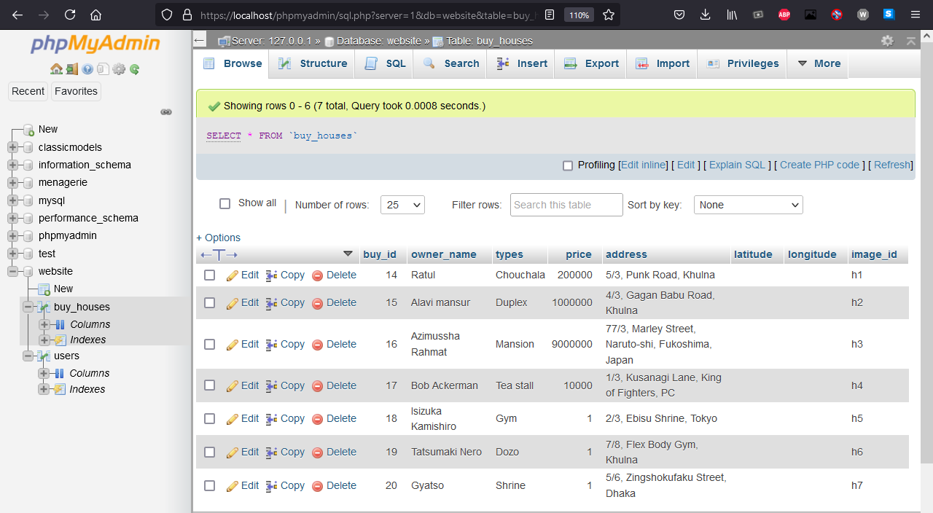
Features: Database before buying

Slide 10
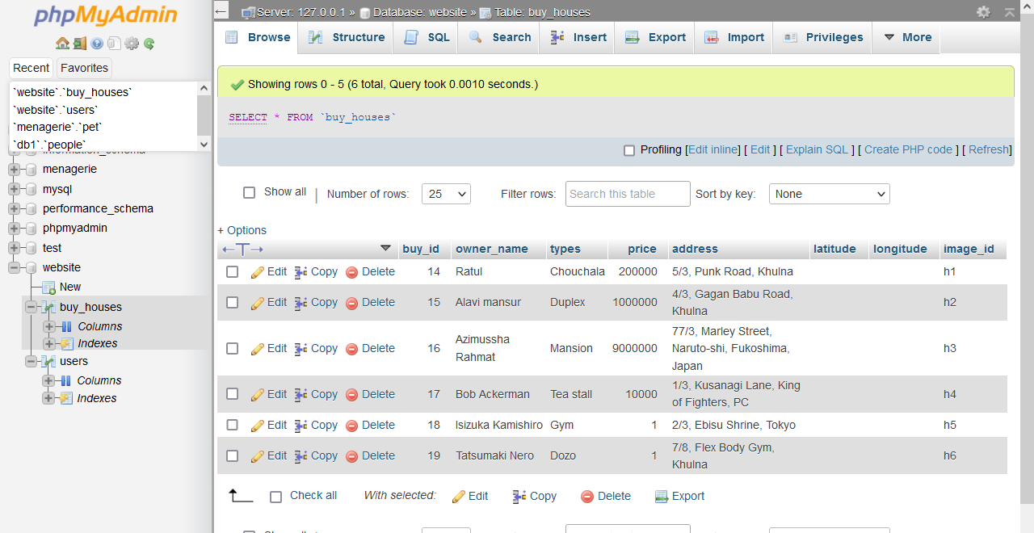
Features: : Database after buying

Slide 11
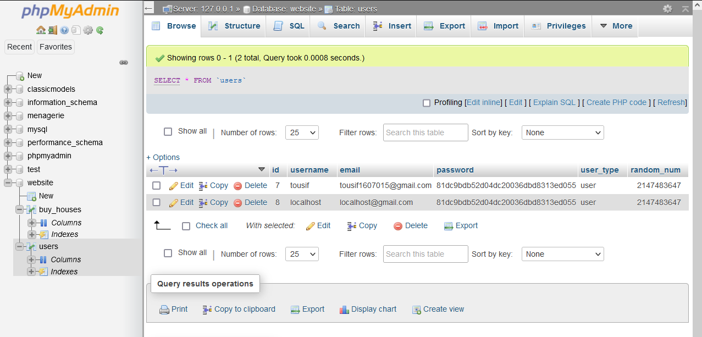
Features: user table

Slide 12
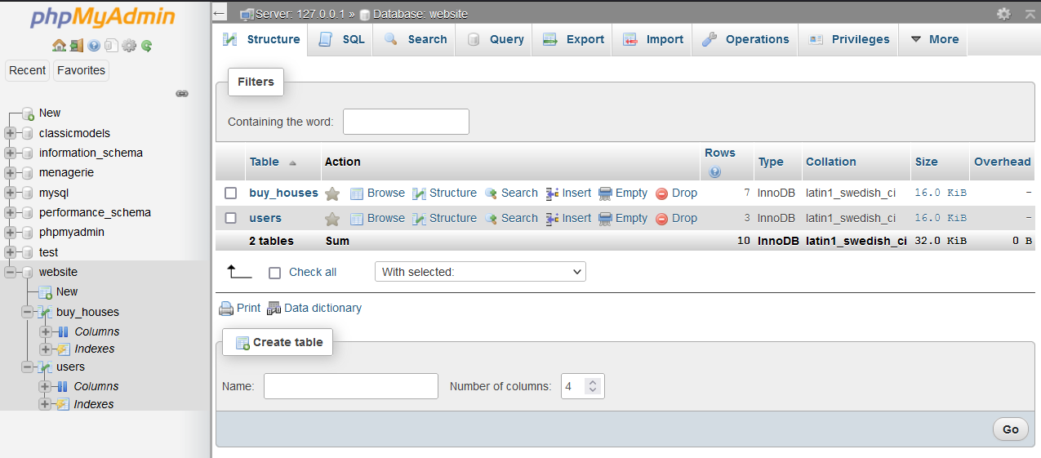
Features: Database

Slide 13
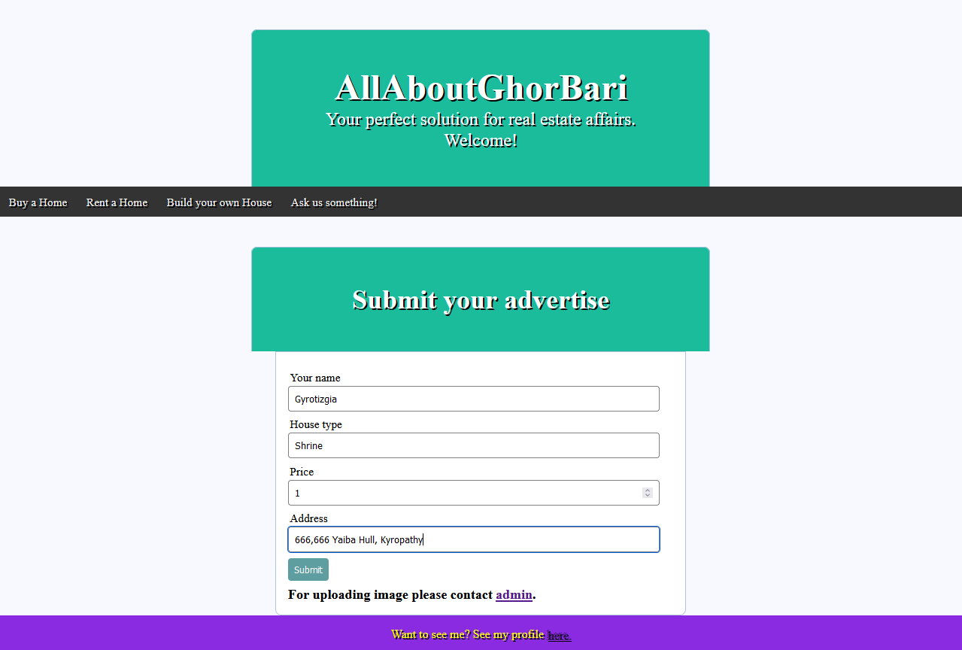
Feature: Submit advertise

Slide 14
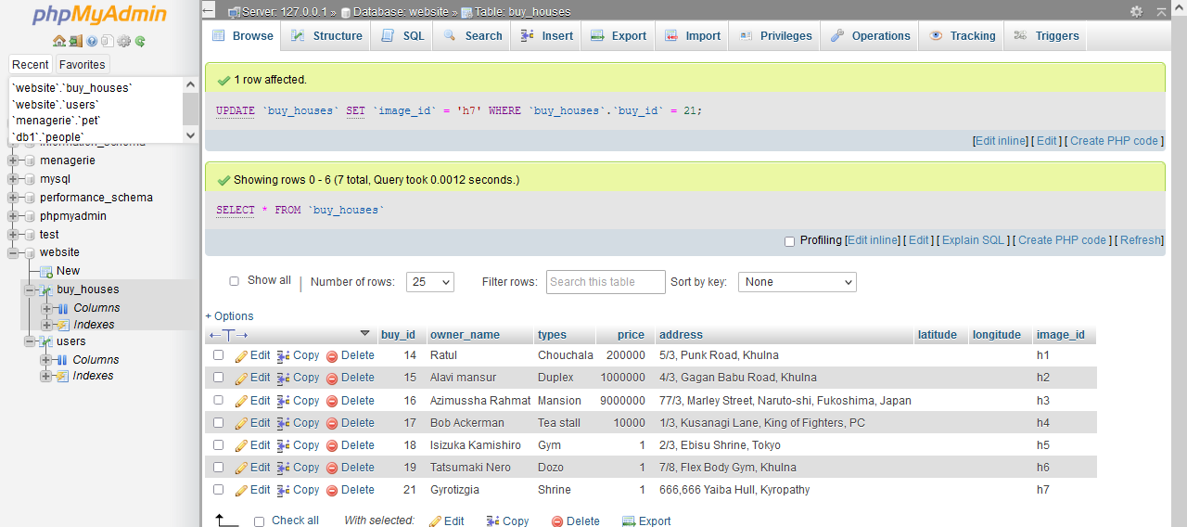
Database after advertise

Slide 15
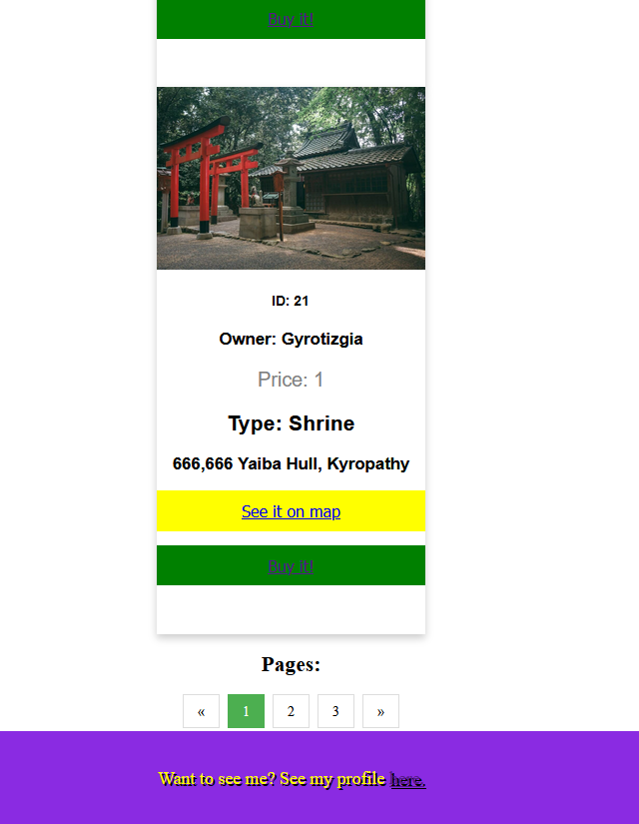
New added house in advertise list

Slide 16
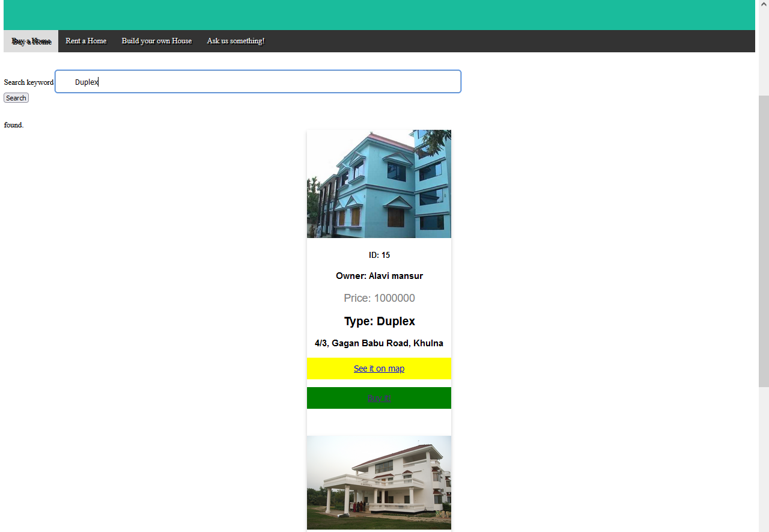
Feature: search house by type

Slide 17
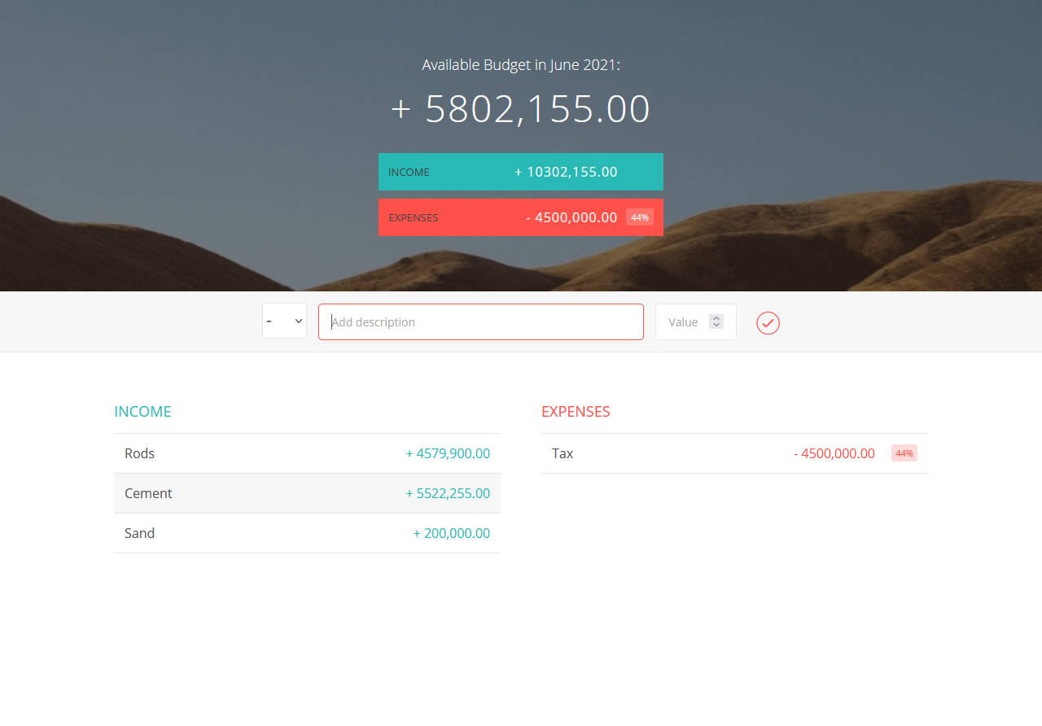
Feature: Build House section, 1st is an calculator and rest 2 are hyperlink to websites,

Slide 18
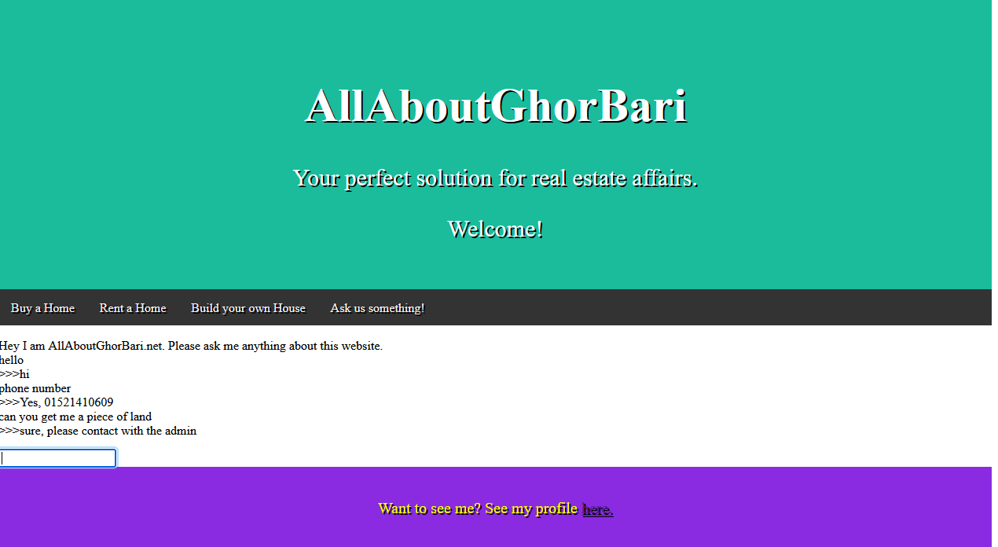
Feature: Interactive chatbot response

Slide 19
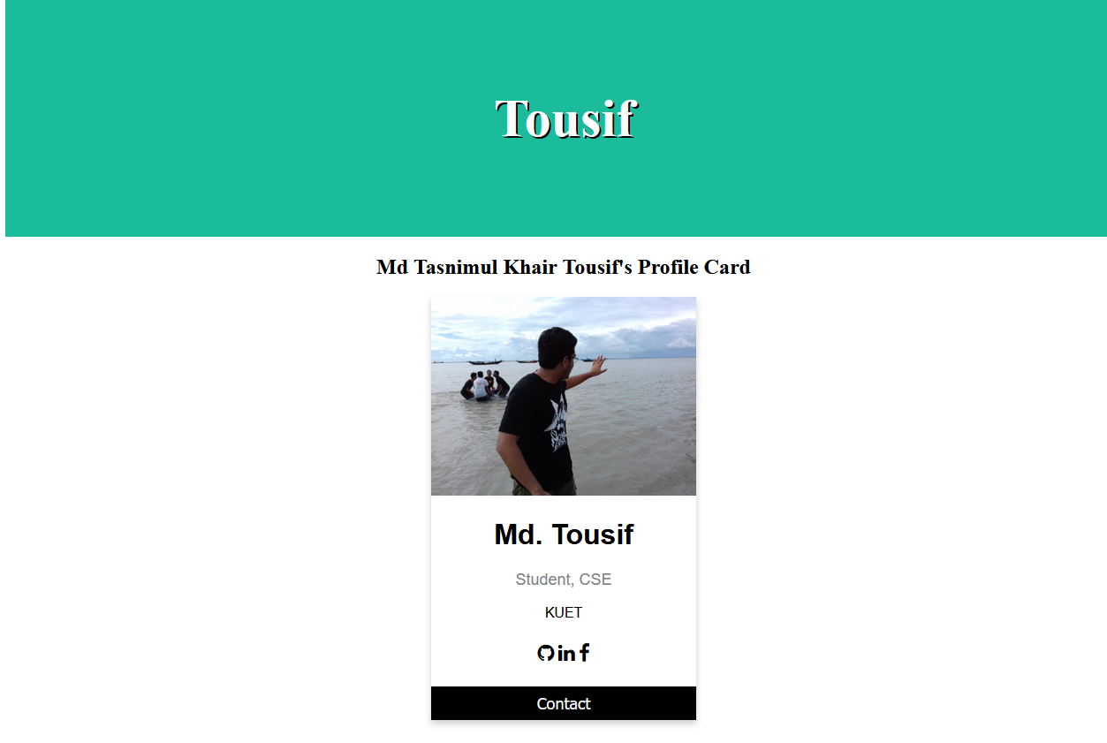
Profile card

Slide 20
Done!
Thanks for your interest!

